Slide 1


Whitehorse Youth
Representative
Committee
Annual Report 2022

Slide 2
Background…
Whitehorse Youth Representative Committee (WYRC) was established in 2002
Provide a formal link between young people and Whitehorse City Council.
Key objectives of the WYRC
WYRC Committee member benefits
WYRC Recruitment

Slide 3

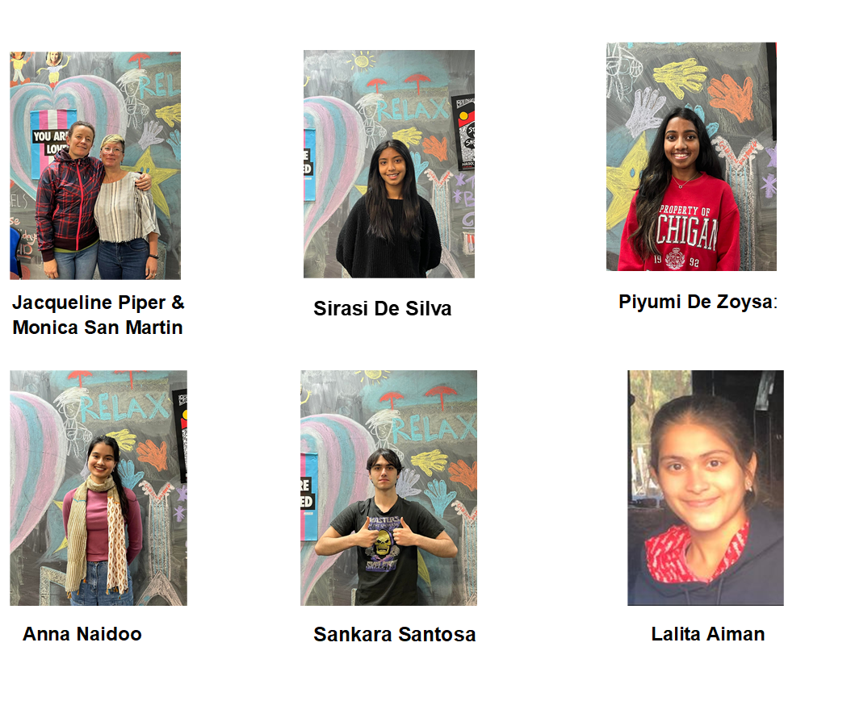
WYRC 2022

Slide 4
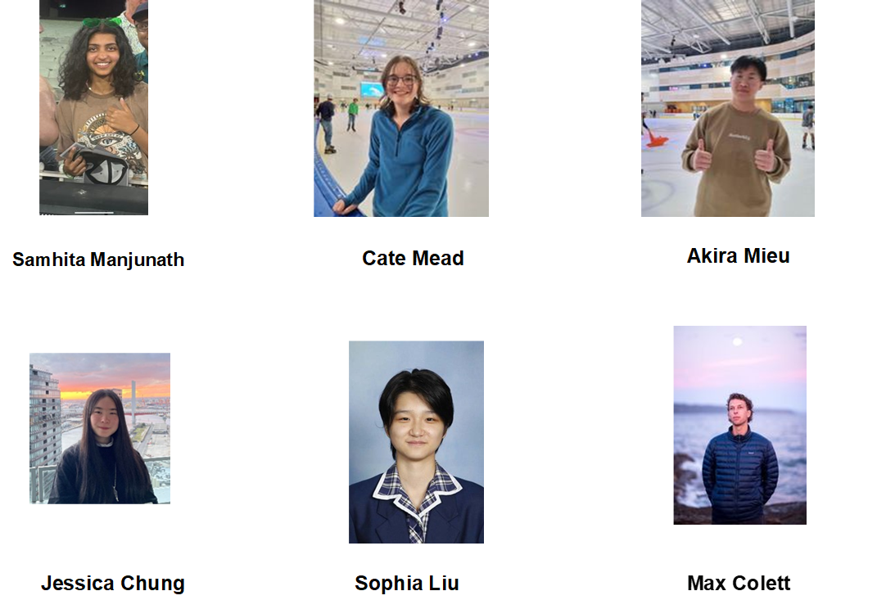

WYRC 2022

Slide 5
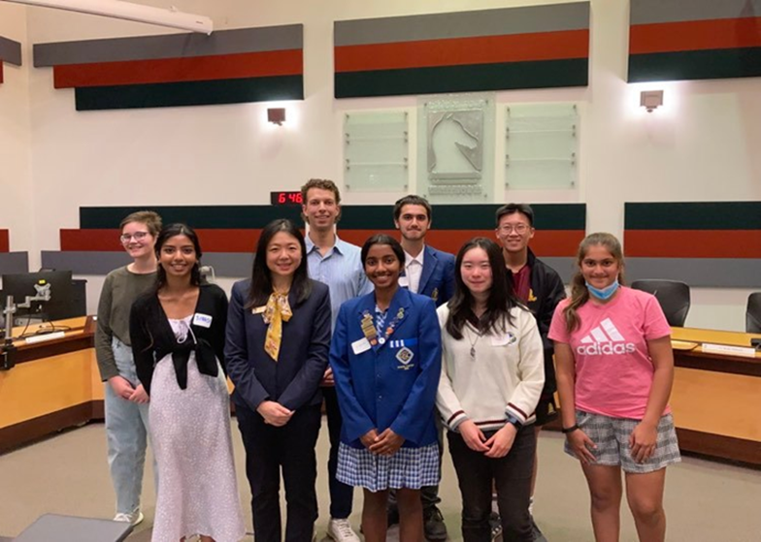
WYRC Induction
WYRC formal
Inductions
Mayor Tina Liu

Slide 6
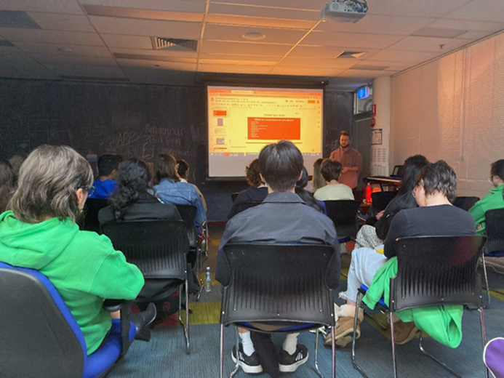
WYRC Training
Cultural Awareness with Centre for Multicultural Youth
Activism and Advocacy
with Nevo Zisin
Radio Basics with the
Student Youth Network
Media at RMIT
First Aid Workplace Level 2
St Johns
Event Management with Seanzel He

Slide 7

Young Person of the Month
Young Person of the Month Award acknowledges young people aged 12 to 27 for their achievements and for making exceptional contributions to the Whitehorse Community.
Areas of arts, culture, sport, music, learning, drama and community participation
Young Citizen of the Year

Slide 8
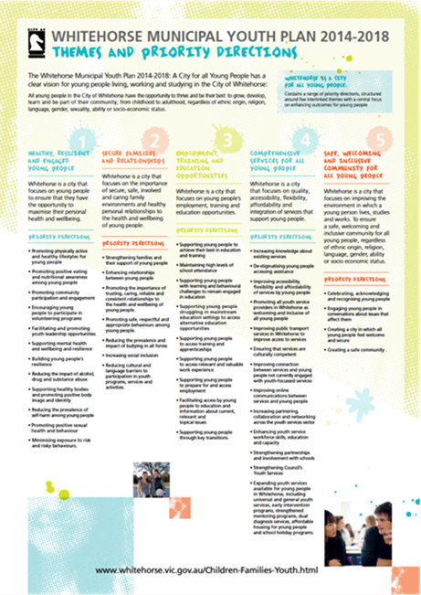
Municipal Youth Plan Consultations
WYRC 2021 Annual Survey development
WYRC 2022 Annual Survey input
WYRC 2023 Municipal Youth Plan Consultations scheduled
WYRC 2023 Annual Online Survey concept to continue

Slide 9

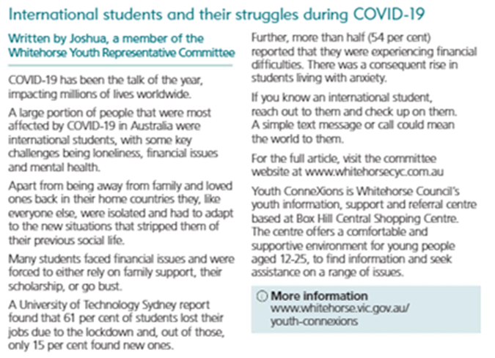
Whitehorse News Articles
Advocacy and education for the community in regard to youth issues.
Training on how to write an WN article.
Promotion plans for 2023

Slide 10

WYRC Annual Youth Forum
Youth Forum - Box Hill Town Hall 21st October
Themes and issues: Self Care and the Inner World, Interpersonal Relationships and Consent, Independence and Future Skills and a focus on life skills.
Key note address: Nevo Zisin
Interactive workshops from: The Butterfly Foundation, Helen Zee, Mario D’Souza and Elephant Ed.
Expo: EACH (Eastern Access Community Health),
The Butterfly Foundation, the Migrant Information
Centre, and Headspace.

Slide 11
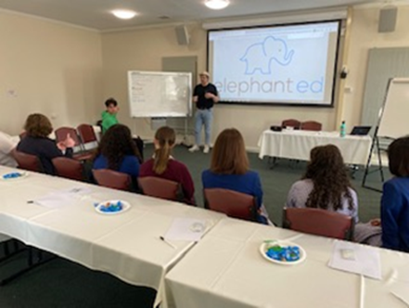
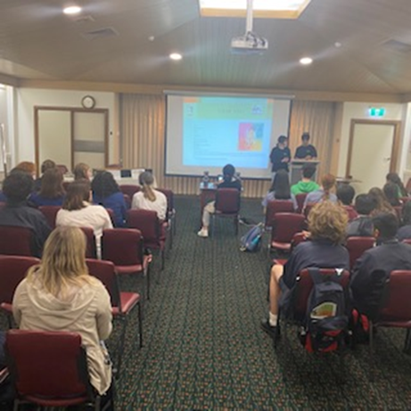
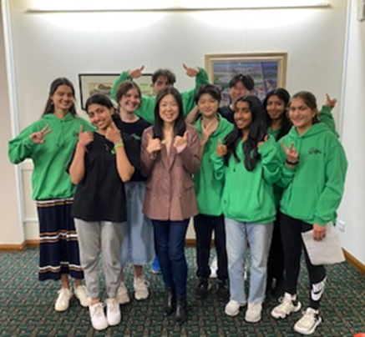
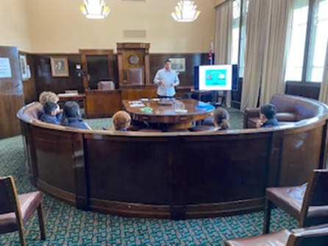
WYRC Annual Youth Forum
Reflections…

Slide 12

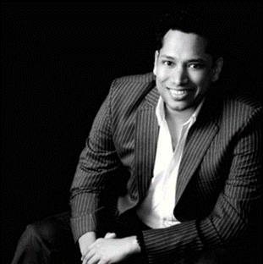


Online Workshops

Slide 13
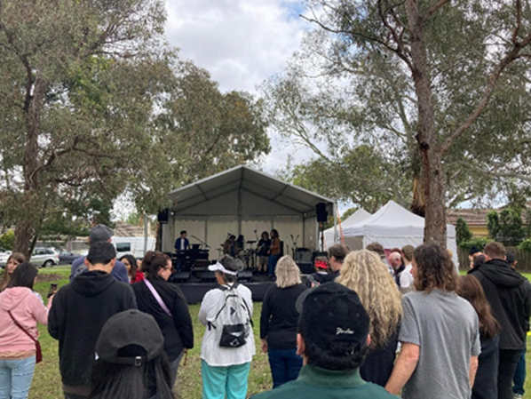
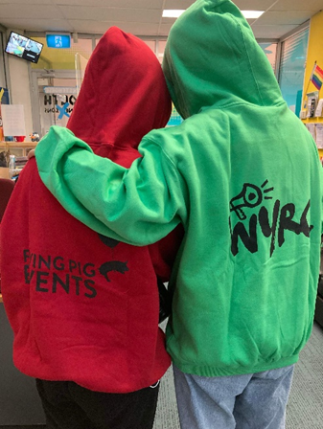
Spring Festival
Youth Area: WYRC – FReeZA Flying Pig Events and Youth Services collaboration.
Activities

Slide 14
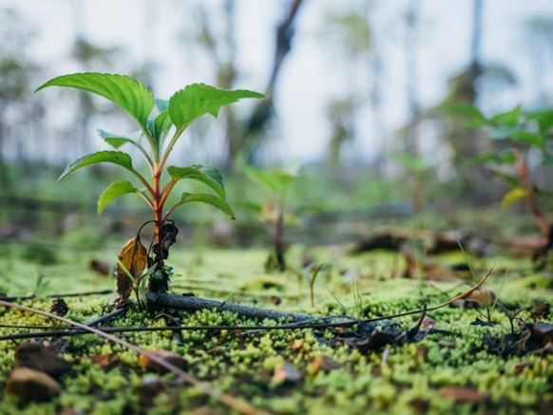
Environmental Sustainability Focus
Collaboration with Cassie Lukes Environmental Volunteer Support Officer at Council.
Meeting attended by member of WYRC 2021 and WYRC 2022 as a starting point.

Slide 15

Plans for 2023…
Advocate for the best interests of young people.
Organise and implement the Whitehorse Municipal Youth Forum in August
To specifically advocate and address key issues impacting on young people and report back to Council
To be involved in the consultation process in the development of the next iteration the Youth Plan.

Slide 16
Recommendation
Council acknowledge the work of the 2022 Whitehorse Youth Representative Committees and endorse the Committees initial action plans for 2023.

Slide 17
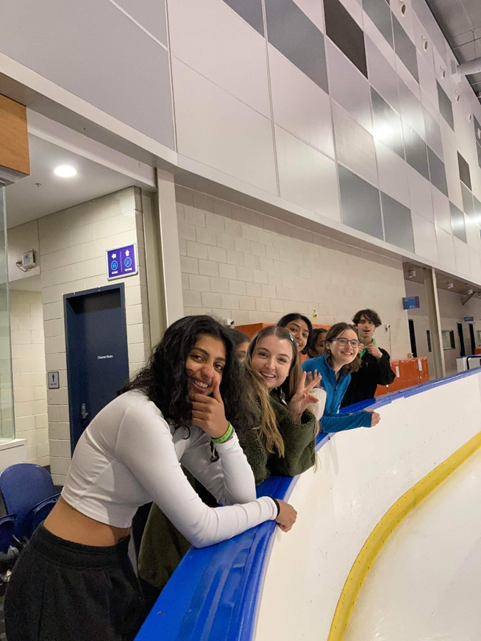
Thank you!
The 2022 WYRC would like to thank Whitehorse City Council and Youth Services for providing the opportunity to volunteer in the local community and gain valuable knowledge and experience.

Slide 18


