Slide 1
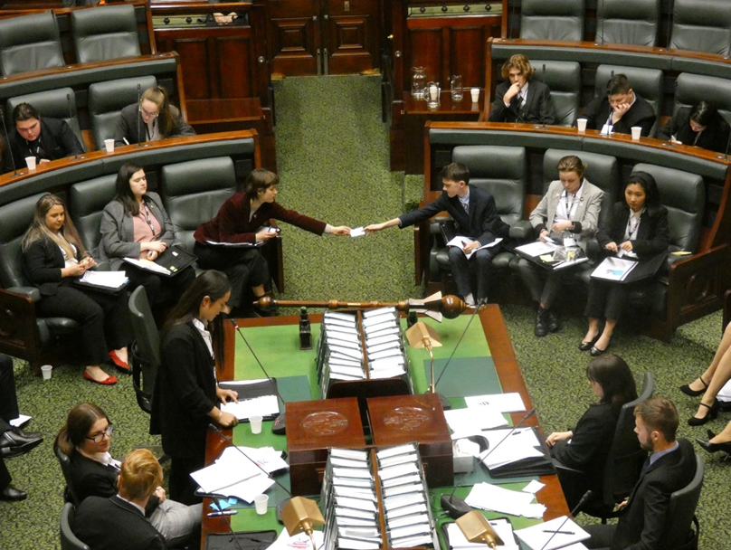
Whitehorse YMCA Youth Parliament 2023 Report

Slide 2
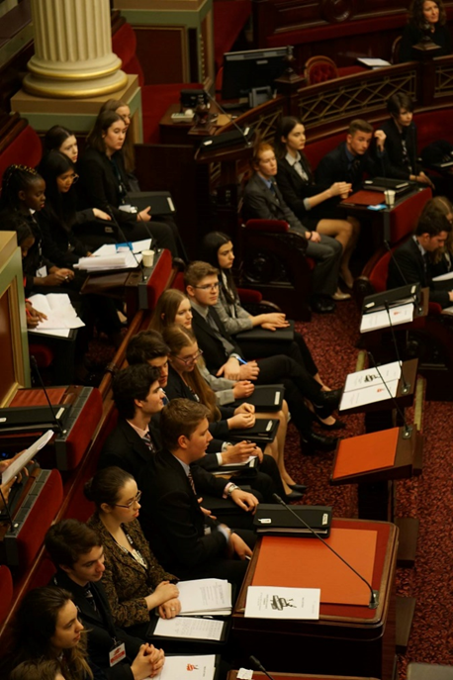
What is Youth Parliament?
Annual Residential program facilitated by the YMCA for the last 35 years
Draws together 20 teams comprised of 6 young people aged 16-25 from across Victorian local government, community organisations, and schools
Advocate for issues that matter to young people
During this time, 30 pieces of state legislation have originated in the Youth Parliament
Notes:
Youth Parliament is an annual residential program run by the YMCA that has run for the last 35 years. It draws together 20 teams (each comprised of 6 young people aged 16-25) from across Victoria to advocate for issues that matter to us. Across the span of 5 months, we will learn about the Victorian legislative system, develop advocacy and community leadership skills, and create and debate our own proposed legislation (Bill) on an issue that we are passionate about.
The program is delivered in 3 blocks:
Drafting and finalising of our chosed Bill topic
Training Weekend in May 2023
Sitting Week in June 2023
We will explain more about these blocks a bit later
Fun Fact: 30 pieces of legislation have originated in the 35 years of Youth Parliament.

Slide 3
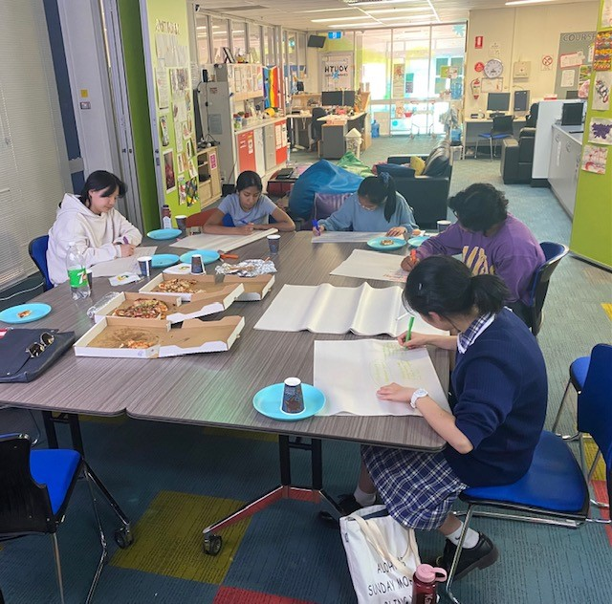
Whitehorse Youth Parliament Members
Amy Bai
Age 16
Aakarsh Kumur
Age 17
Yuting Wang
Age 17
Sirasi De Silva
Age 22
Angus R
Age 16
Harper Lam
Age 16
Notes:
We would like to introduce you to the 6 young members of the Whitehorse Youth Parliament Team: (Read Names)
Members are aged between 16-22 years and attend local high schools or universities. We represent some of Whitehorse’s diverse community (over half of us identify as being from a culturally and linguistically diverse background).

Slide 4
Interest in Program
The five main reasons for wanting to join:
Interest in parliament, legislation, and the function/role of the State and Federal Government
Youth voice
Creating change
Training & skill development / demonstration
Connection
Notes:
The applications of members highlighted five main reasons for wanting to join the Whitehorse team for the 2023 Youth Parliament:
All of us have an interest in parliament, legislation, and the function/role of the State and Federal Government
We are also passionate to included the voice, experience and opinions of young people in political discourse and legislation
The opportunity to contribute to positive change and make a meaningful impact on our community was also common for all of us
The opportunity to participate in Training & Skill Development attracted us as well as having the platform to be able to demonstrate these skills.
All of us thought the opportunity to connect with like minded young people and learn about the diversity of opinions was really important. We also wish to network with important stakeholders and parliamentary members

Slide 5
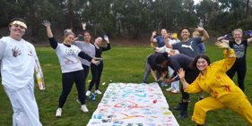
Youth Services Involvement
Application successful to host a Whitehorse 2023 Youth Parliament Team
Promotion and recruitment
Diversity in background and experiences
Collaborative program delivery with YMCA
Meetings
Bill Topic
Notes:
Whitehorse Council Youth Services applied for and were successful to have a team of 6 young people participate in the YMCA Youth Parliament program in 2023.
Promotion and recruitment occurred during December 2022 and early in 2023 with 9 Expression of Interest received from young people. After an interview process six young people were accepted onto the Whitehorse YMCA Youth Parliament team with 2 young people placed onto a ‘wait list’.
The program taskforce mentor (YMCA staff member) and Council Youth Worker are currently working collaboratively in supporting all of us in the program and we all meet fortnightly / monthly.
So far we have brainstormed Bill topics to find our preferred top 3. From these 3 we were allocated the Bill topic we would create and debate in Parliament. Our Bill topic is 'Modernisation of the Education System' which we will explain more about in the next slide. We are currently working on drafting the Bill including coming up the relevant clauses, and all details of the Bill will be finalised by the 28th April.

Slide 6
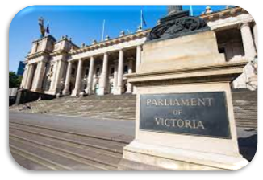
Bill Topic
'Modernisation of the Education System'
Notes:
'Modernisation of the Education System'. What do we mean by this?
We are proposing innovations to learning modes, assessment frameworks and career integration. These proposals recognise and extend pandemic-inspired learning adjustments and new legislation around vocational pathways.

Slide 7
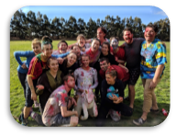
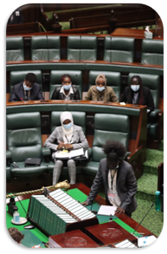
Next steps
Finalisation of our Bill: 28 April
Training Weekend: 26-28 May
Sitting Week: 25-30 June
Notes:
On the 28th April we will have our Bill finalised
We are then looking forward to attending the training weekend at Lake Dewar Discovery Camp which will focus on preparing us to debate our Bill. We will focus on things such as parliamentary etiquette and debate, practise debating, engage in media training, and be interviewed by the Youth Press Gallery. We will also establish the Chambers for sitting week including appointment of leadership roles, and engage in skill development sessions covering topics such as confidence and leadership. A few fun activities will also be thrown in
The Whitehorse YMCA Youth Parliament team will then attend the Victorian Parliament sitting days from 25th to 30th June to debate our Bill. Here we will connect with community change makers and continue to build leadership and advocacy skills. We will travel by bus to Parliament house on three of these days to participate in the sitting week. Each team will have an opportunity to sponsor (argue for) our Bill and refute (argue against) on another teams proposed Bill. We will also conduct a short speech (adjournment debate) directed to a state MP on the importance of Modernising our Education System.

Slide 8
Thank you
We look forward to sharing the outcome with you

